Slide 1
Andrew Miracle
STRUCTURING A JAVASCRIPT PROJECT

Slide 2

INTRODUCTION
I AM ANDREW MIRACLE
Code validator on indorse.io and Founder of Tecmie, a Software Consulting Company.
Currently an EIT @MESTAFrica
Twitter: @koolamusic
Website: www.andrewmiracle.com

Slide 3
Structuring a Javascript Project
What is the first thing you do when you have a project idea ?

Slide 4
Structuring a Javascript Project
First Steps
Craft the perfect name
Buy a Domain
Open terminal
create a folder
Initialize GIT

Slide 5






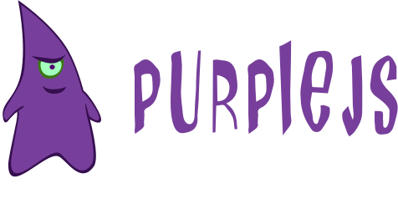





CHOOSE A JAVASCRIPT FRAMEWORK

Slide 7


YOU + ME + package.json
=

Slide 8
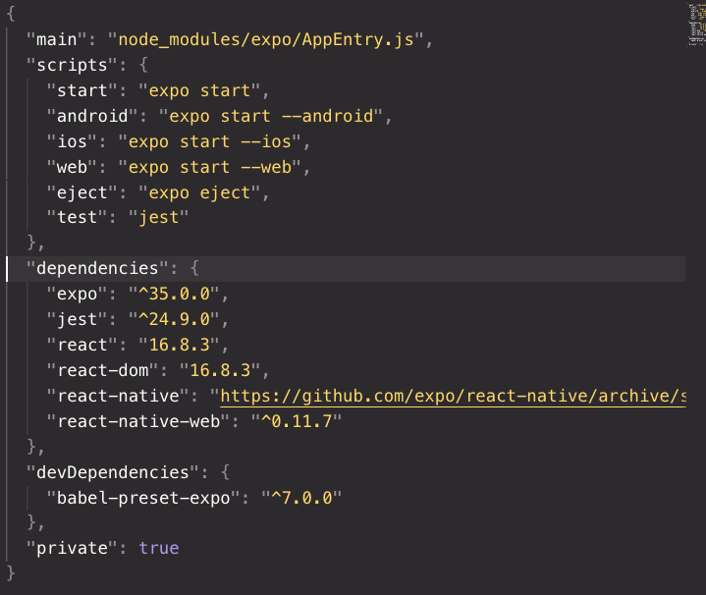
Structuring a Javascript Project

Slide 9
GETTING STARTED CAN BE UNREASONABLY CONFLICTING
Structuring a Javascript Project

Slide 10
Package Manager
Application Architecture – (SPA, Universal or Isomorphic)
Folder structure
Code Paradigms - DRY - SOLID
Target Devices - Mobile, Web, IOT
Frontend Frameworks
API Framework
Bundlers, Builds & Task Runners
CSS & CSSinJS
CI /Deployment
Structuring a Javascript Project

Slide 11
HARD TRUTH
IT DOESNT REALLY MATTER HOW YOU DO YOUR JOB, AS LONG AS YOU GET SHIT DONE

Slide 12
TARGET DEVICES
Structuring a Javascript Project

Slide 13




Mobile
REACT NATIVE
NATIVE
SCRIPT
IONIC/
PHONEGAP
METEOR/
CORDOVA
https://facebook.github.io/react-native/
https://www.nativescript.org/
https://ionicframework.com/
https://meteor.com

Slide 14
IOT
OBNIZ
NODE RED
CYCLON.JS
JERRY SCRIPT
https://obniz.io/
https://nodered.org/
https://cylonjs.com/
https://jerryscript.net/

Slide 15
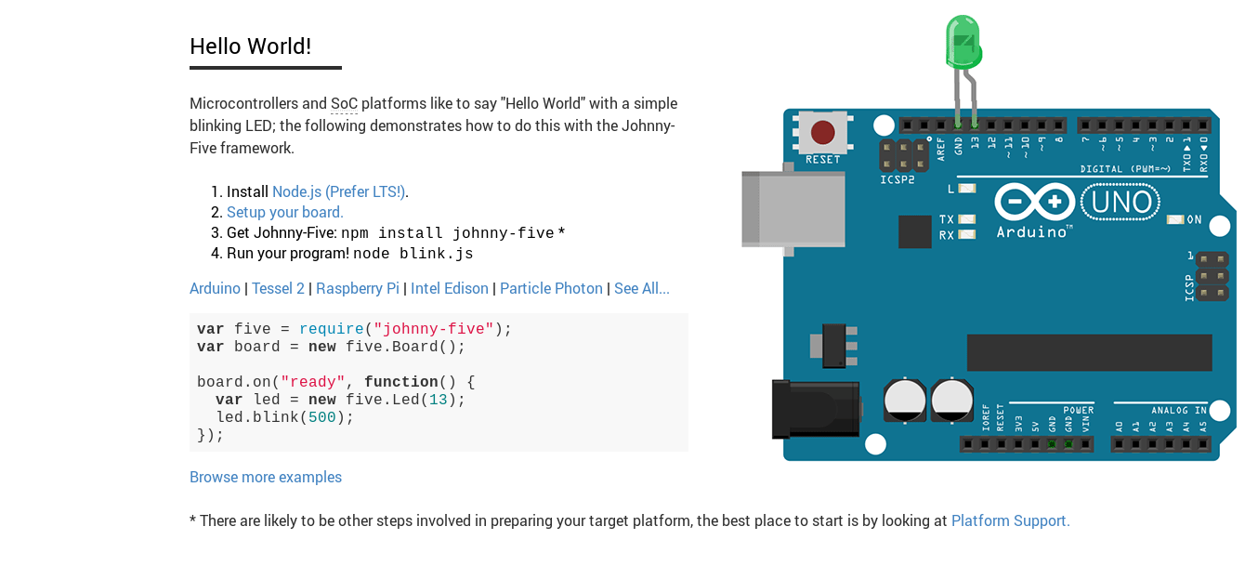
IOT
HELLO WORLD IOT WITH J5
http://johnny-five.io/

Slide 16
Frontend
REACT
ANGULAR
VUEJS
EMBER
https://reactjs.org/
https://angular.org
https://vuejs.com/
https://emberjs.org

Slide 17


API
APOLLO
METEOR
LOOPBACK
EXPRESS
SAILS

Slide 18




Package Managers

Slide 19



APPLICATION ARCHITECTURE
SPA - SINGLE PAGE APPLICATIONS
The most common, high-level architecture for web applications is called SPA, which stands for Single Page Application. SPAs are big blobs of JavaScript that contain everything the
application needs to work properly. The UI is rendered entirely client-side, so no reloading is required.

Slide 20
APPLICATION ARCHITECTURE
ISORMORPHIC/ UNIVERSAL APPS
An isomorphic app is a web app that blends a server-rendered web app with a single-page application. On the one hand, we want to take advantage of fast perceived performance and SEO-friendly rendering from the server.
In this type of architecture, most of the code can be executed both on the server and the client. You can choose what you want to render on the server for a faster initial page load, and after that, the client takes over the rendering while the user is interacting with the app.

Slide 21
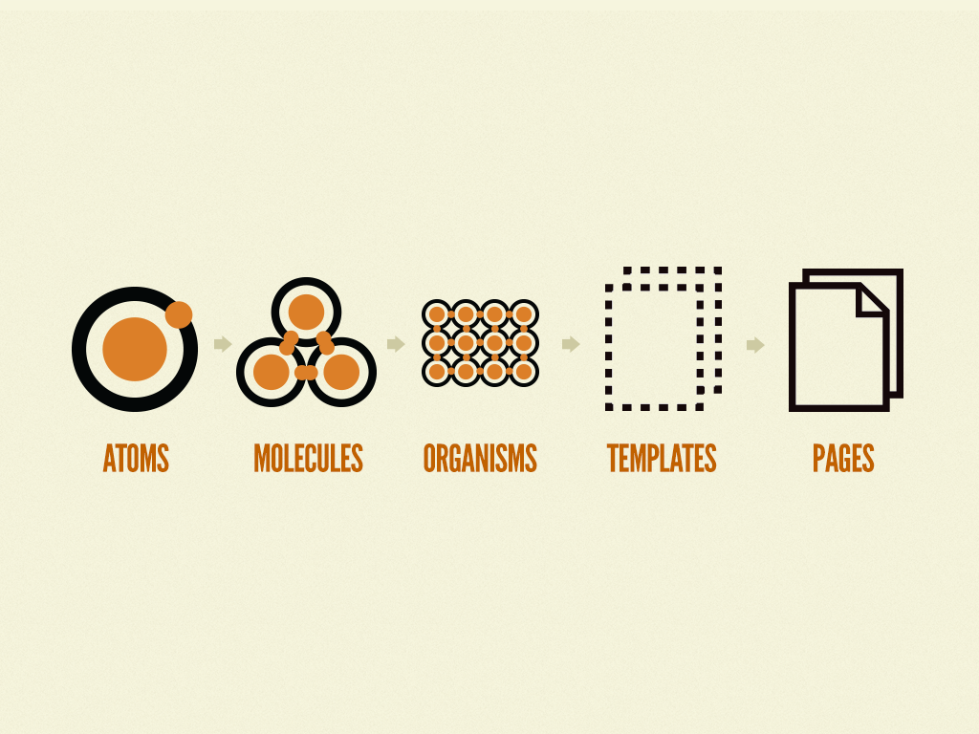
FOLDER STRUCTURE
ATOMIC DESIGN PRINCIPLE - BEST APPLIED IN FE DEV.

Slide 22
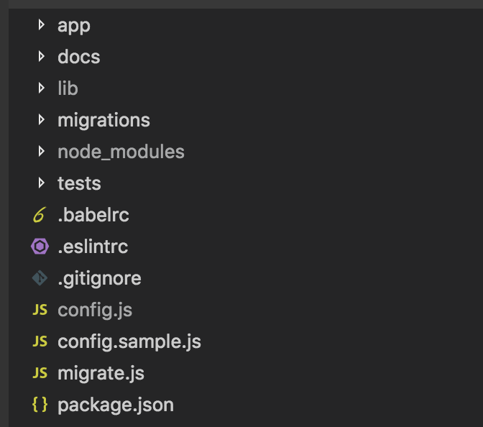
FOLDER STRUCTURE
FRACTAL APP STRUCTURE- BEST APPLIED IN BE DEV.

Slide 23
CSS LIBRARIES
CSS IN JS

Slide 24

CSS LIBRARIES
Zurb Foundation
https://foundation.zurb.com/
Tachyons CSS
https://tachyons.io/
Bulma CSS
https://bulma.io/

Slide 25
CSS-IN-JS
THERE SO MANY CHOICES

Slide 26
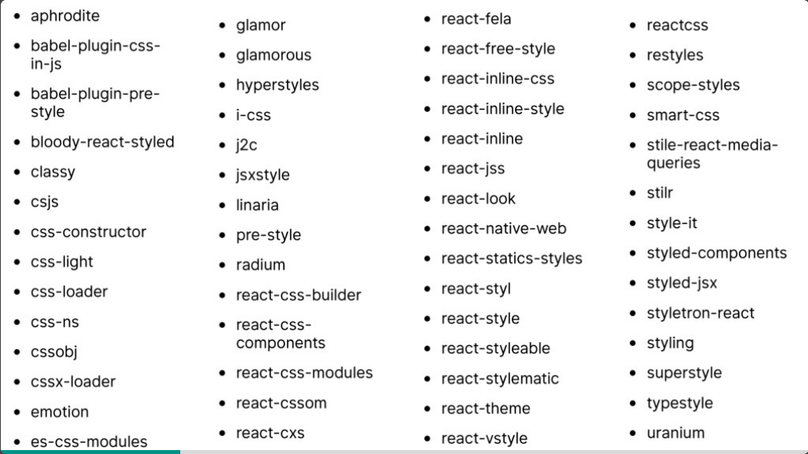
CSS IN JS

Slide 27
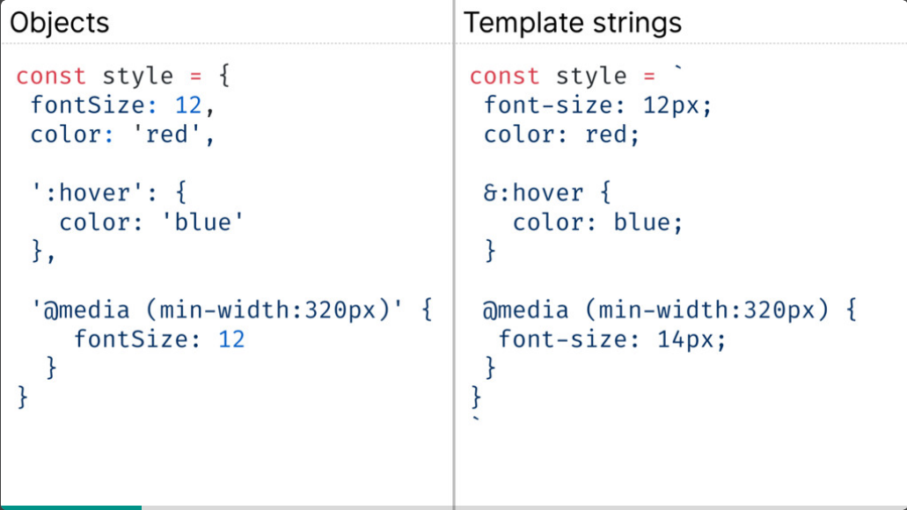
CSS IN JS == JS

Slide 28
BUNDLERS AND TASK RUNNERS
WEBPACK, PARCEL, ROLLUPJS

Slide 29
WEBPACK
Webpack is an open-source JavaScript module bundler. It is a module bundler primarily for JavaScript, but it can transform front-end assets like HTML, CSS, and images if the corresponding plugins are included. Webpack takes modules with dependencies and generates static assets representing those modules.
HTTPS://WEBPACK.JS.ORG/
PARCEL
Parcel is a web application bundler, differentiated by its developer experience. It offers blazing fast performance utilizing multicore processing, and requires zero configuration.
HTTPS://PARCELJS.ORG/

Slide 30
DEPLOYING YOUR APP
IAAS
Infrastructure As A Service
PAAS
Platform As A Service
SAAS
Software As A Service

Slide 31


INFRASTRUCTURE AS A SERVICE
IaaS or Infrastructure as a Service is basically a virtual provision of computing resources over the cloud. An IaaS cloud provider can give you the entire range of computing infrastructures such as storage, servers, networking hardware alongside maintenance and support.

Slide 32


PLATFORM AS A SERVICE
Platform as a Service or PaaS is essentially a cloud base where you can develop, test and organize the different applications for your business. Implementing PaaS implifies the process of enterprise software development. The virtual runtime environment provided by PaaS gives a
favorable space for developing and testing applications.

Slide 33
SOFTWARE AS A SERVICE
SaaS or Software as a Service is a model that gives quick access to cloud-based web applications. The vendor controls the entire computing stack, which you can access using a web browser. These applications run on the cloud and you can use them by a paid licensed subscription or for free with limited access.
GALAXY

Slide 34
DRY
DONT REPEAT YOURSELF
SECURITY
Always validate input
Not every feature requires a new npm package
Try to maintain a log
When unsure, use a PAAS
SOLID
Single Responsibility Principle
Open/Closed Principle
Liskov Substitution Principle
Interface Segregation Principle
Dependency Inversion

Slide 35
LET'S TALK!
MAILING ADDRESS
me@andrewmiracle.com
WEBSITE
andrewmiracle.com
@HANDLE
@koolamusic

